Slide 1
CSS Layout
Fred Hicken

Slide 2
Reasons for Use
Structuring Data You want all your most important data to be the largest and most visible, Consider the main purpose of the site in question and give them the largest portion of the layout.
Usability & Flow Using a layout will let you more easily direct the flow of your site, not only will this make the site more usable for visitors but easier to handle and maintain as the dev.
Flexible & Responsive Layouts allow us to build websites that will be flexible and responsive to users and what type of device they are accessing our site from.
Clear Division By creating clear division between elements we can be assured the users will no confuse one piece with another and keep away from what ensuing confusion may cause.

Slide 3
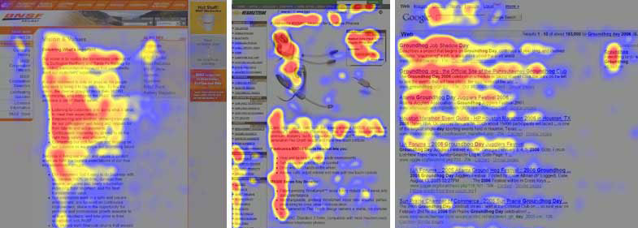
Structuring Data
Reading patterns play a large part of data structuring and layout for a site. You’re on the clock as soon as your user starts reading, make it count.
(IMAGE SOURCE : https://thenextweb.com/dd/2015/04/10/how-to-design-websites-that-mirror-how-our-eyes-work/)

Slide 4
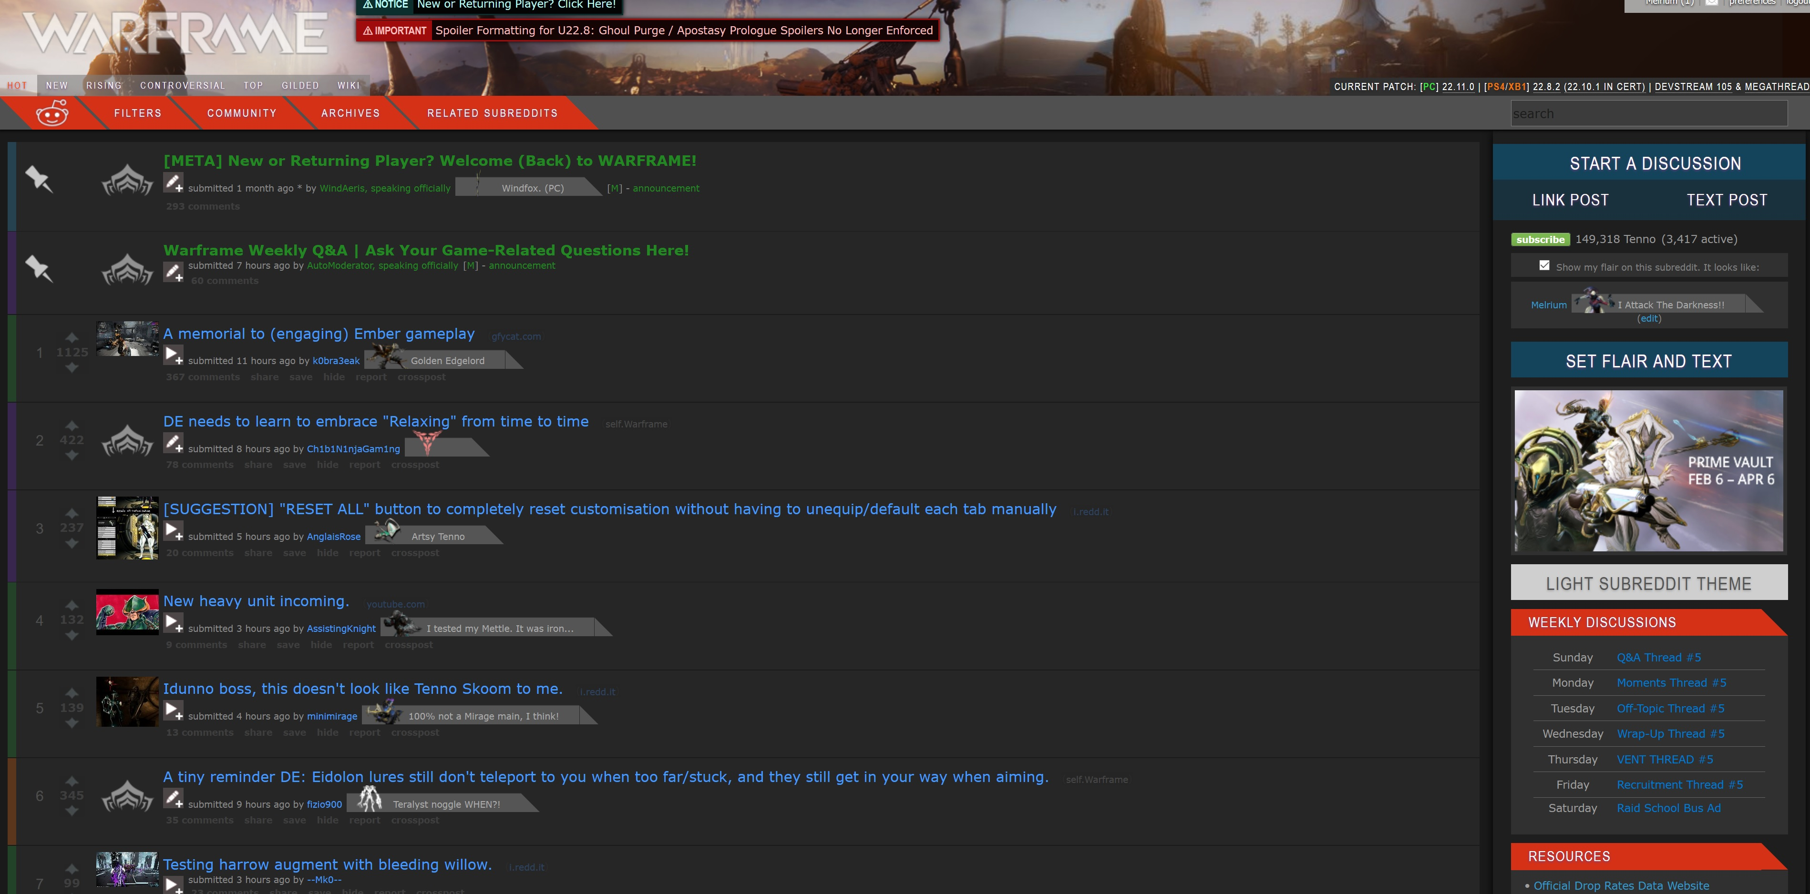
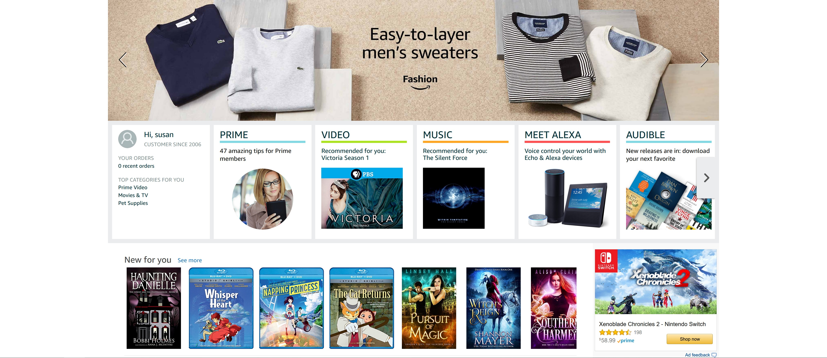
Structuring Data
Consider these two sites and how they present their data, both aiming at completing a different task.
Reddit
Amazon
Simple color coding on the left with small icons a post titles
(https://www.reddit.com/r/Warframe/)
Bold and underlined main points with recommendations.
(https://www.amazon.com/)

Slide 5
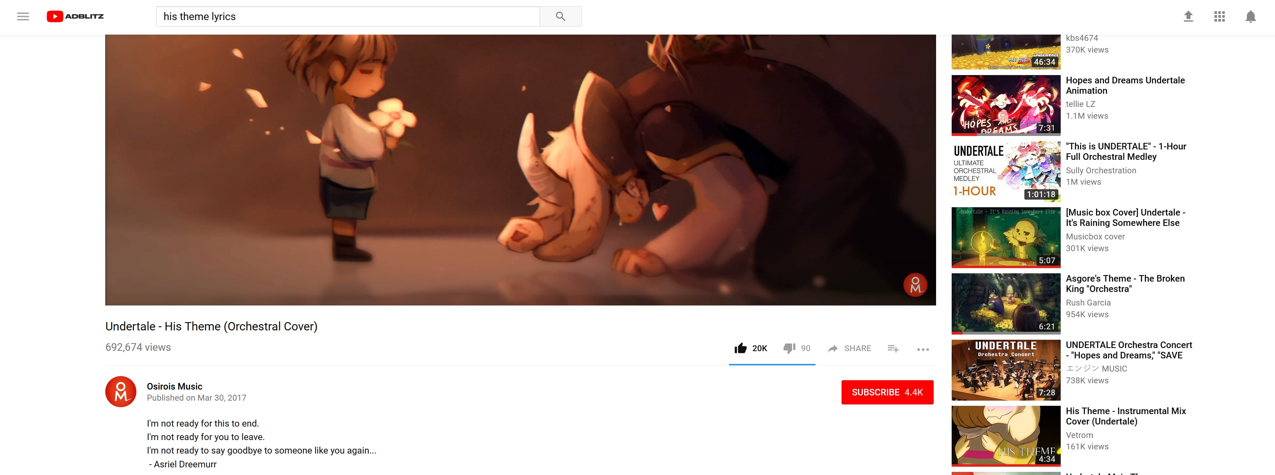
Usability & Flow
Consider elements that are beneficial to users and where they look for them when in need. Consider the sticky top bar on YouTube, you can scroll down looking at comments or recommendations and always have search at you fingertips.
(don’t worry I won’t scroll too far down and subject you to the YouTube comments section)
(https://www.youtube.com)

Slide 6
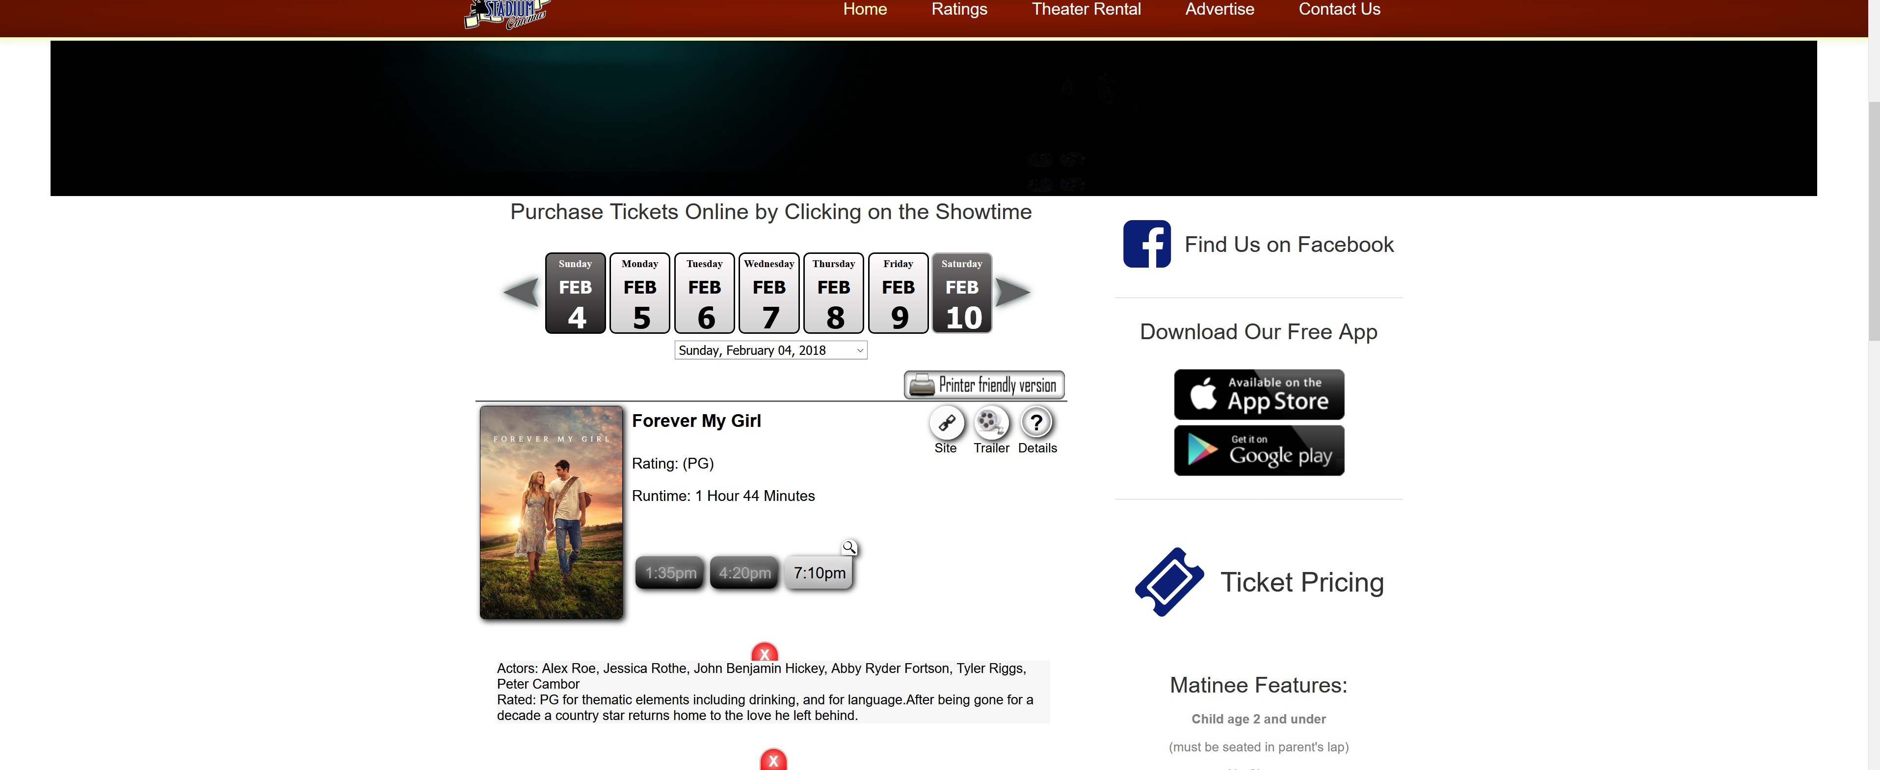
Usability & Flow
This is the website of a local movie theater, while it does mostly what it’s supposed to do there’s a lot of areas that break flow or don’t work the way you think. Like the 2 buttons next to days you’d think they would go forward and backward but they don’t. The left over arrow resets to the current day and the right arrow seems to just reload the page.
(http://stadiumcinemas.com/)

Slide 7
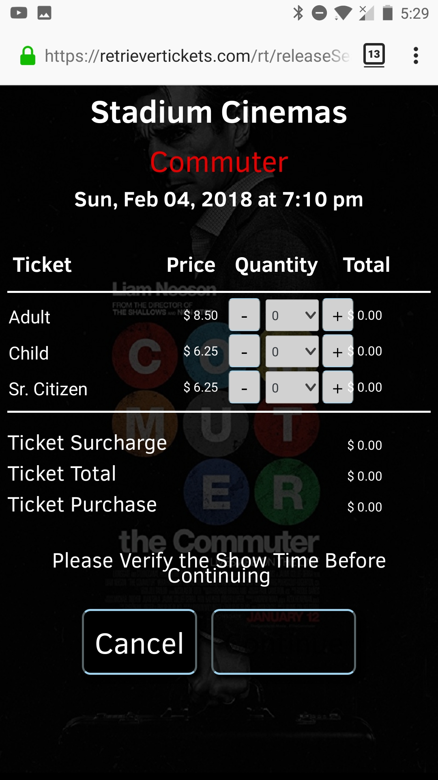
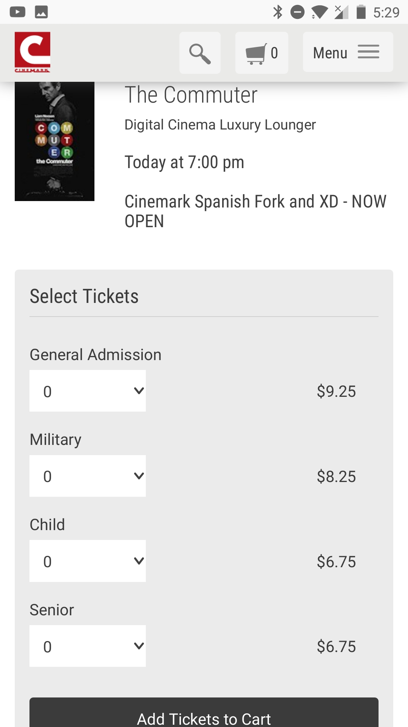
Flexible & Responsive
Using the previous site as a jumping point we can see the difference between a small company
And a large company with lots more to invest into their site.
The continue button is pure black and essentially invisible.
Single Drop down with price and very identifiable.
(http://stadiumcinemas.com/)
(https://www.cinemark.com/utah/cinemark-spanish-fork-and-xd)

Slide 8
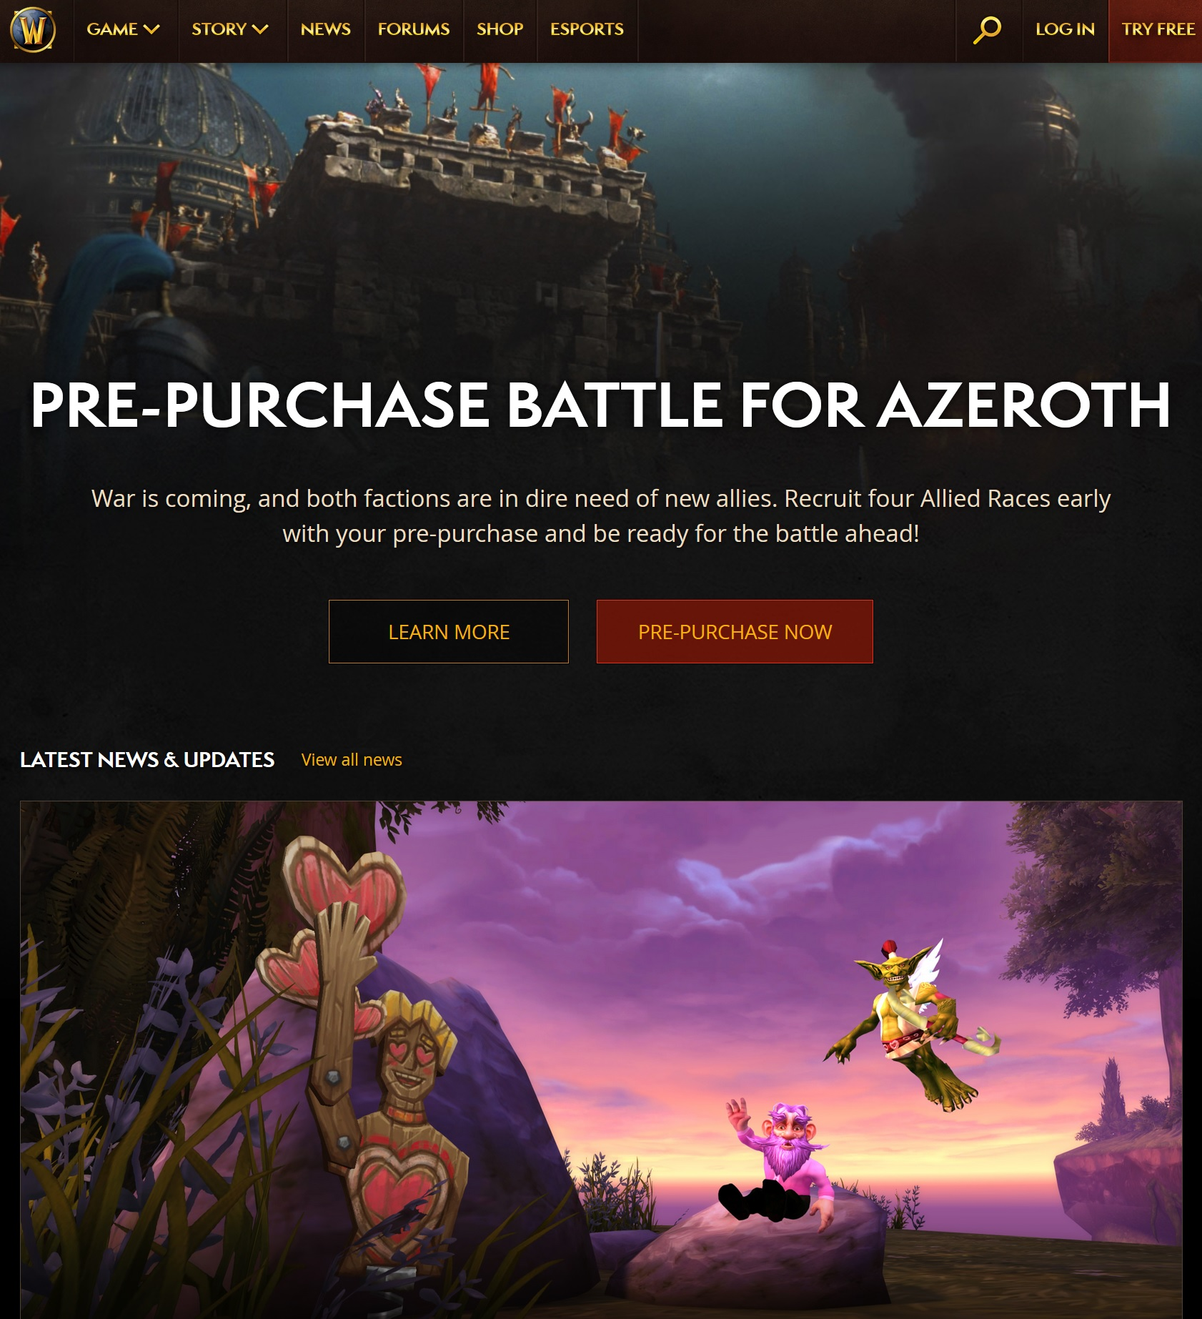
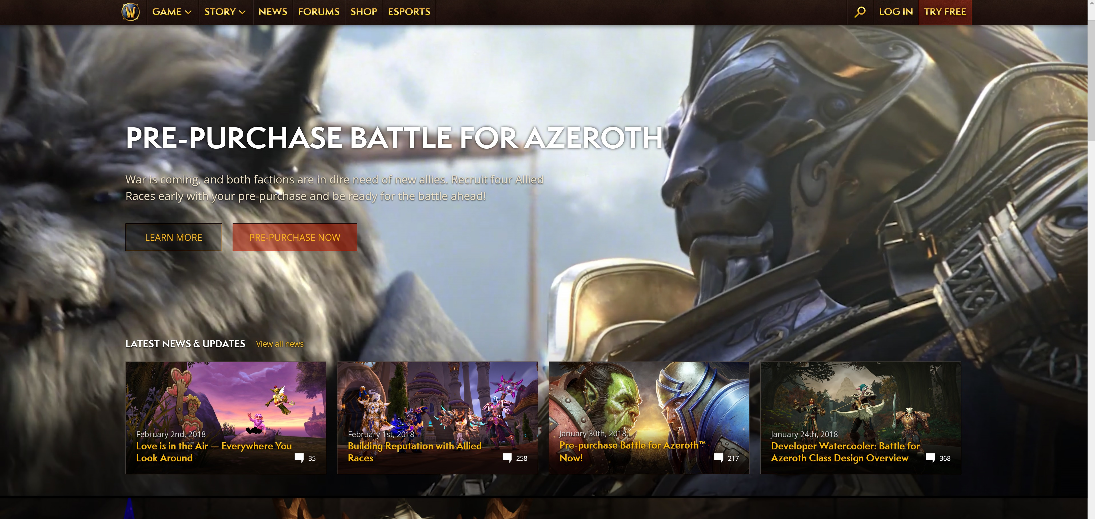
Flexible & Responsive
Speaking of large companies with huge budgets for sites, Blizzard has spent a great deal on their site
over the years. If you go to their site and shrink your window it will automatically switch to a small view,
It will stop playing the small video in the background and align its elements vertically.
World of Warcraft Small
World of Warcraft Large

Slide 9
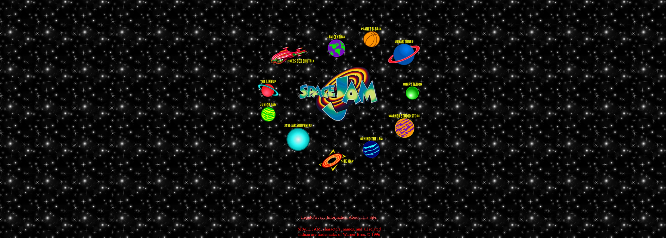
Clear Division
Still around in all its glory, a pre 2000 website that shows off how far web design principle have come. The text is small and hard to read, the alignment seems to have no rhyme or reason,
And finally the background is a small image repeated over and over again.
The division of elements on this site are about as bad as they come compared to our modern standards.
(https://www.warnerbros.com/archive/spacejam/movie/jam.htm)

Slide 10
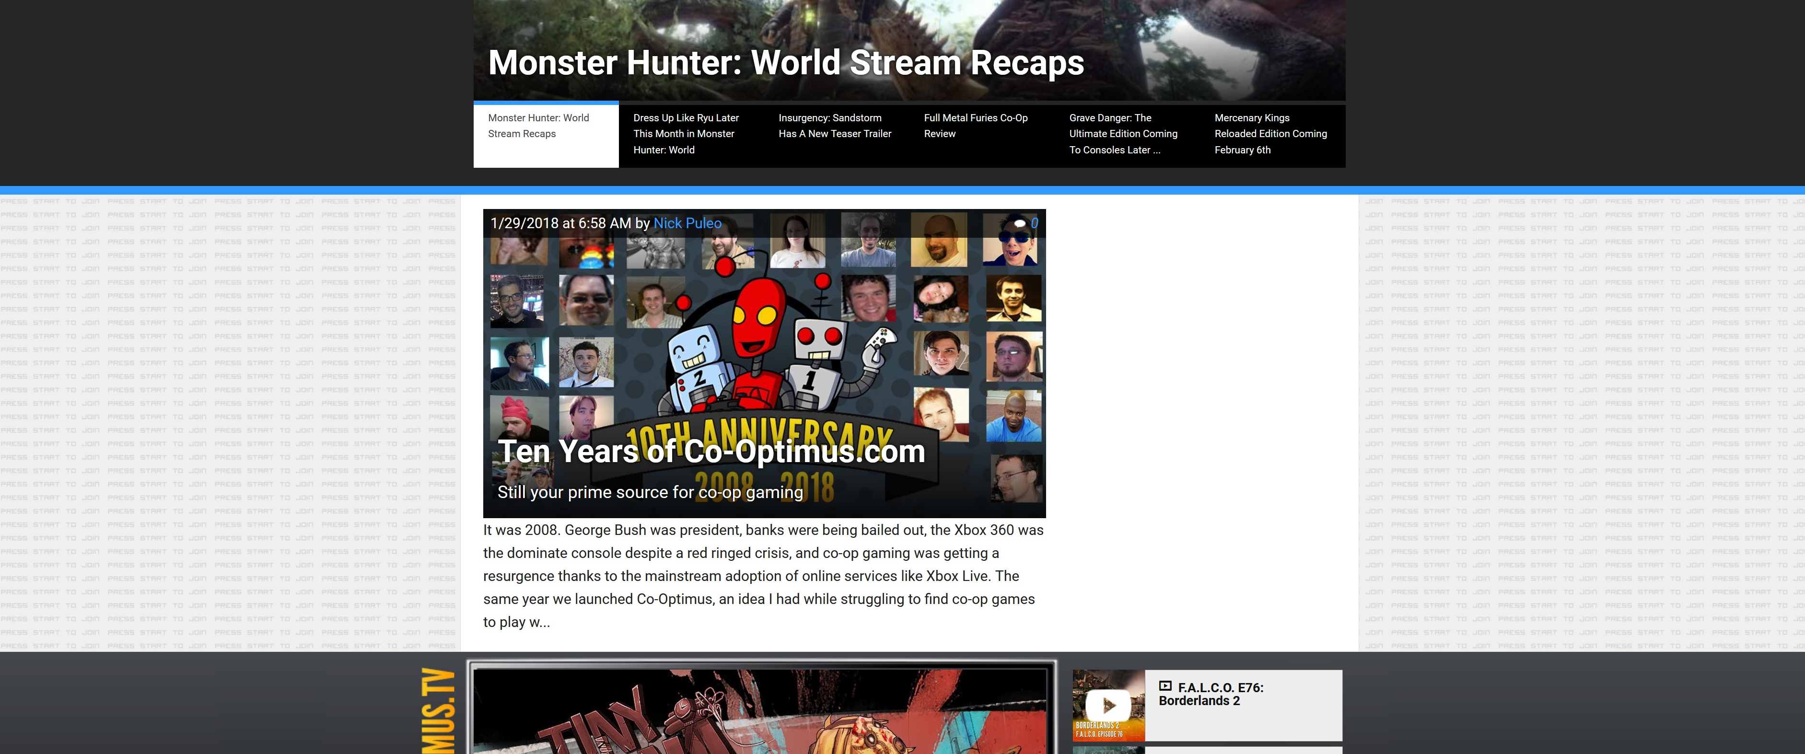
Clear Division
On the flip side of the spectrum you can see this site called co-optimus, which tells you about all the co-op games that are available. It makes use of multiple different types of grouping and separates every section definitively.
(http://www.co-optimus.com/)

Slide 11
TIME FOR SOME CODE
(Spoiler it’s not very good)

Slide 12
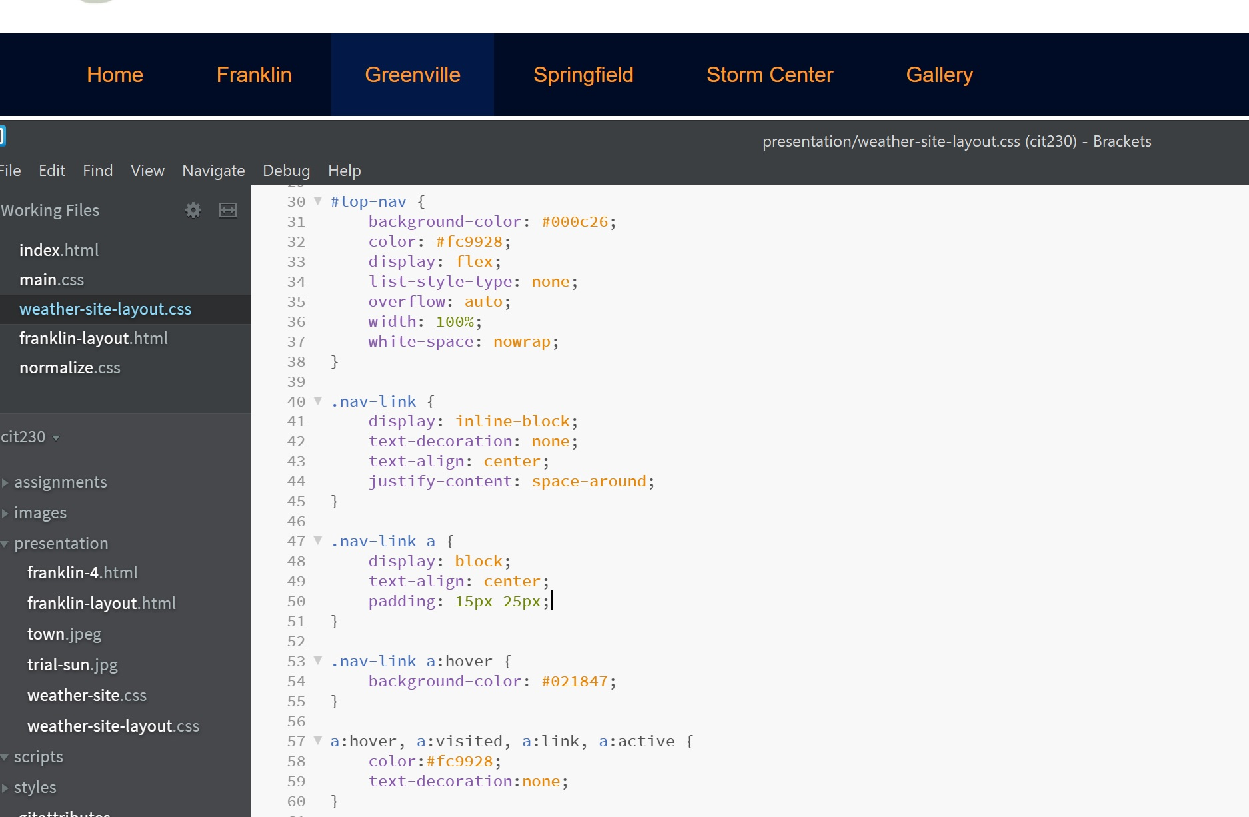
Highlight Links

Slide 13
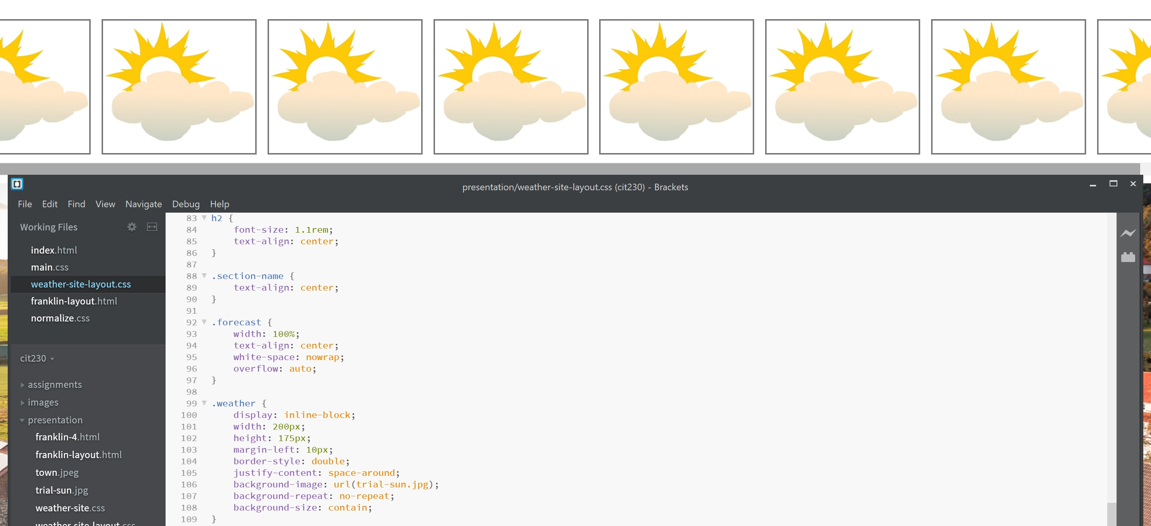
Scroll Bar

Slide 14
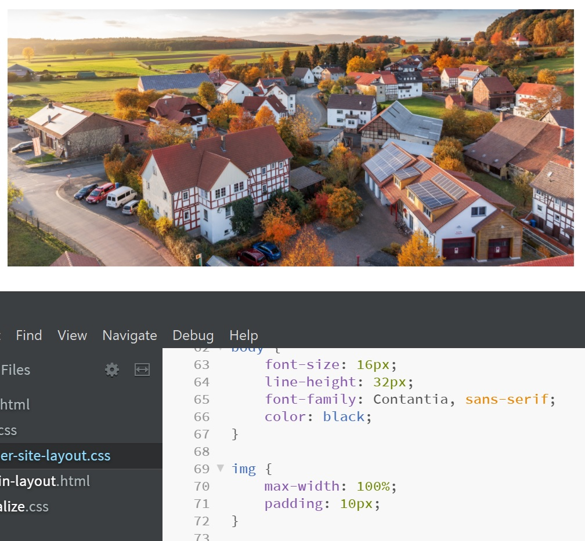
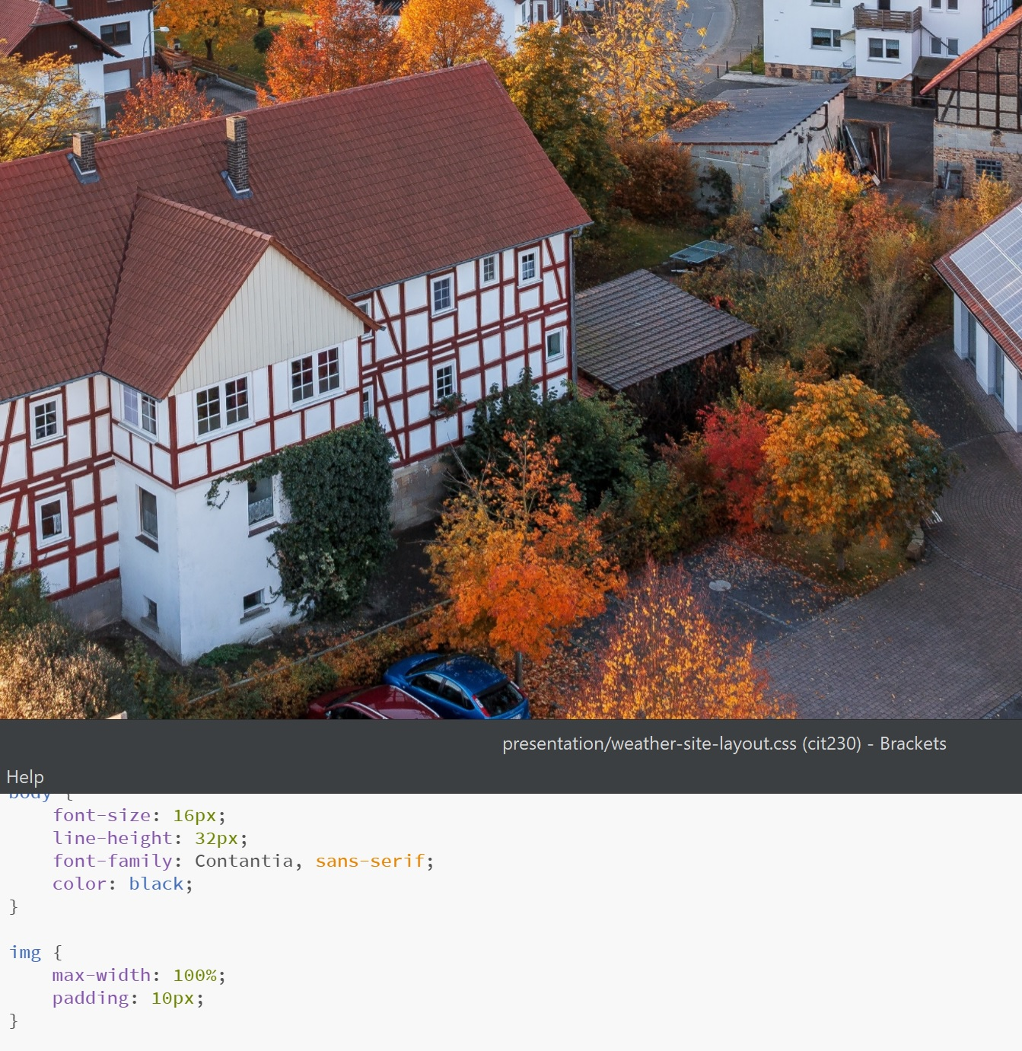
Always keep images the size of the screen with %’s

Slide 15
Thanks for Watching
Check out the links on my post for some more info I found interesting.

